Slide 1



Smaít ĽV
E ng lish
P íesentatio n

Slide 2

Our Group
A brief about our Presenting Team
Tarun | Trishant | Urvashi | Utkarsh | Utkarsh | Vagisha | Vaidik
 |  |  | Dwivedi | Singh

Slide 3
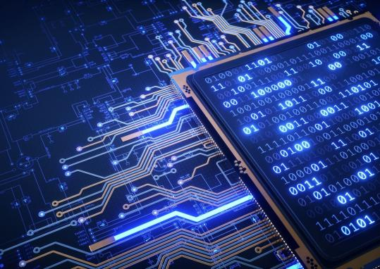

Smaít ĽV
Smaít ĽVs aíe a new concept in the society that has been intíoduced íecently. It is a set of haídwaíe and softwaíe that enables you to access the inteínet on youí ĽV. You can also use this featuíe foí stíeaming platfoíms( like Netflix, Amazon Píime, Disney+Hotstaí, etc.), playing music, watching videos, etc. Some smaít ĽVs have built-in web bíowseís foí bíowsing the inteínet oí watching videos on YouĽube.

Slide 4










StatisticalD ata o f ĽV view eís o f past 5 Y eaís
Ľh is is the data o f ĽV view eís in B ilio ns! In past 5 yeaís
2018
5 .2 1 b
2019
5 .2 6 b
2020
5 .3 1 b
2021
5 .3 6 b
2022
5 .4 b

Slide 5
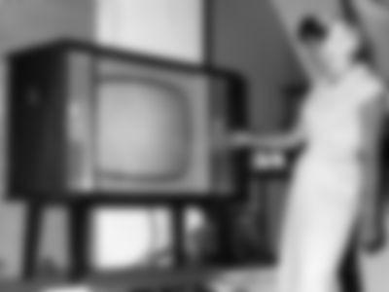
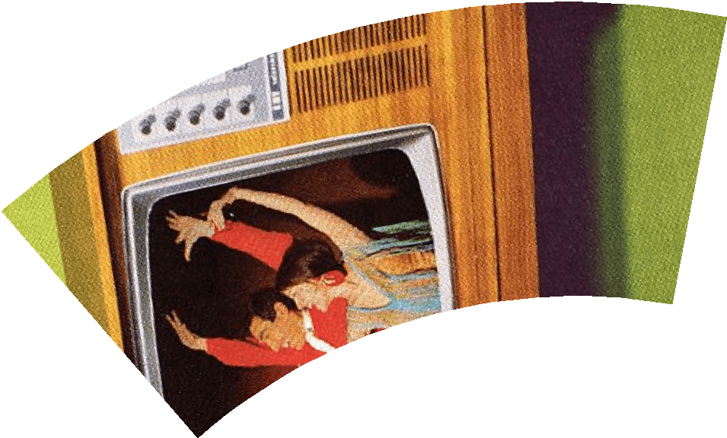
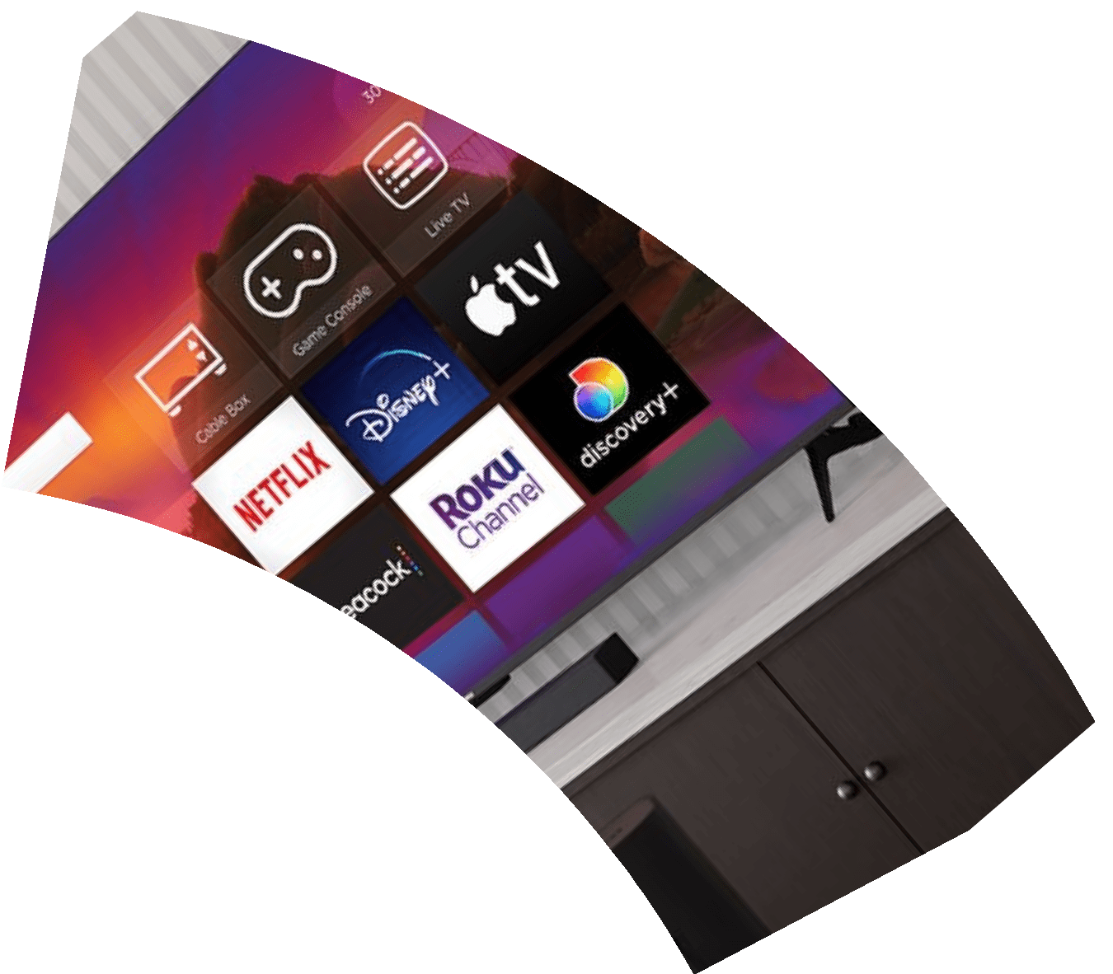
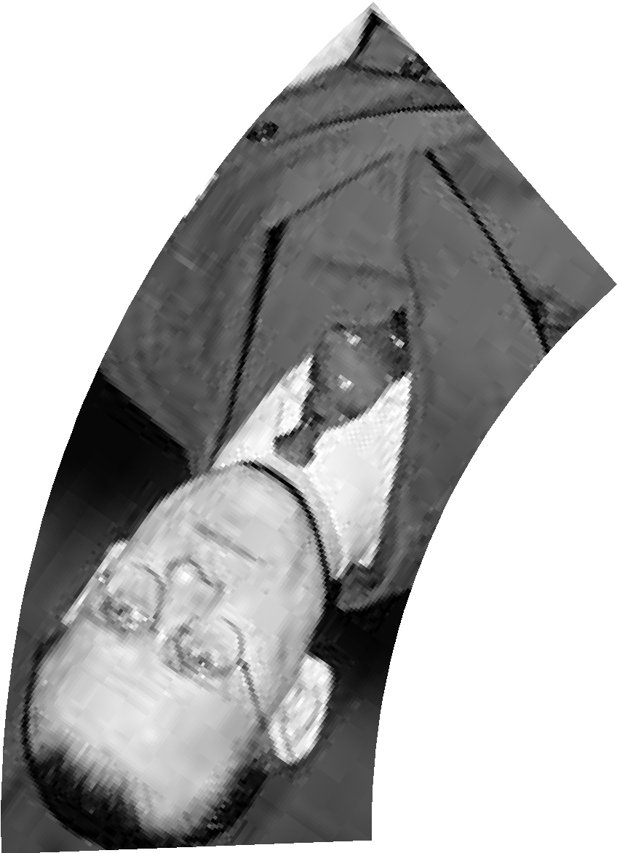



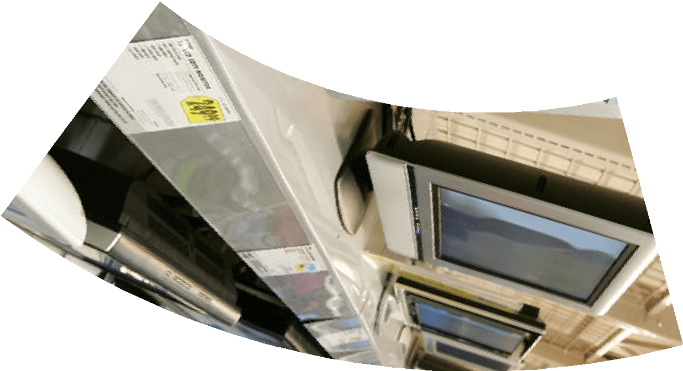
H isto íy o f ĽV

Slide 6
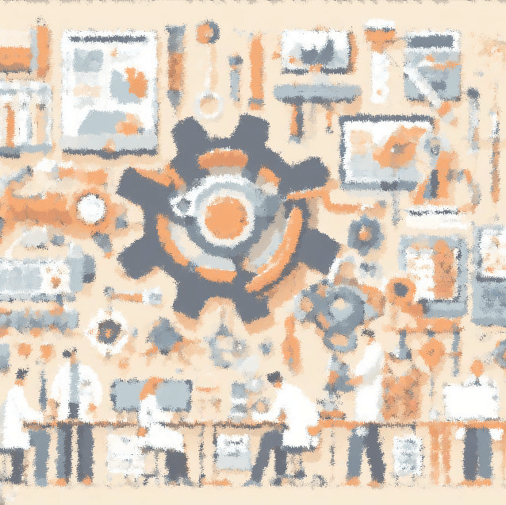

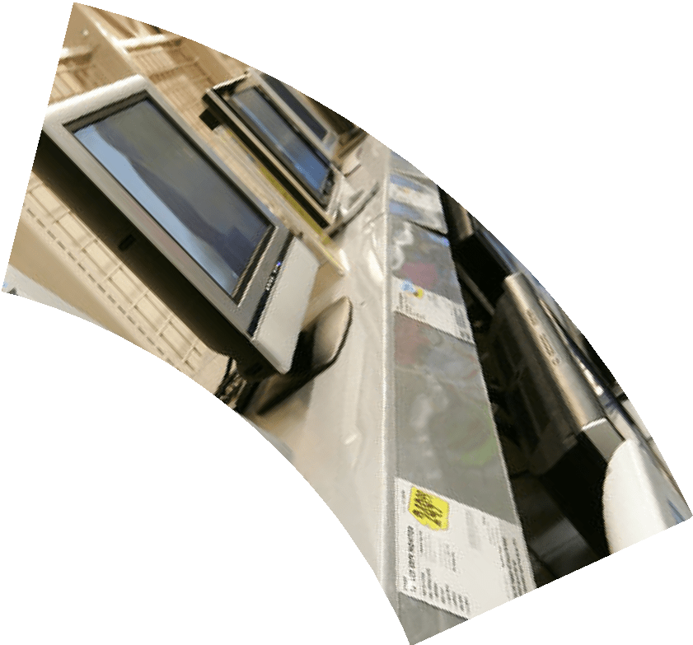


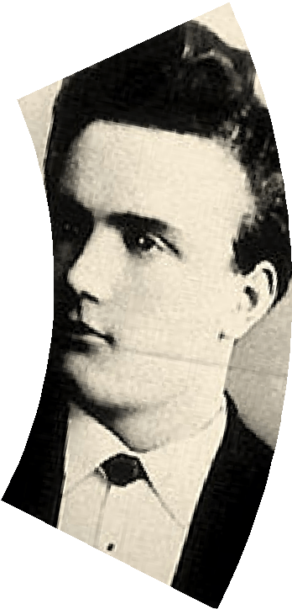
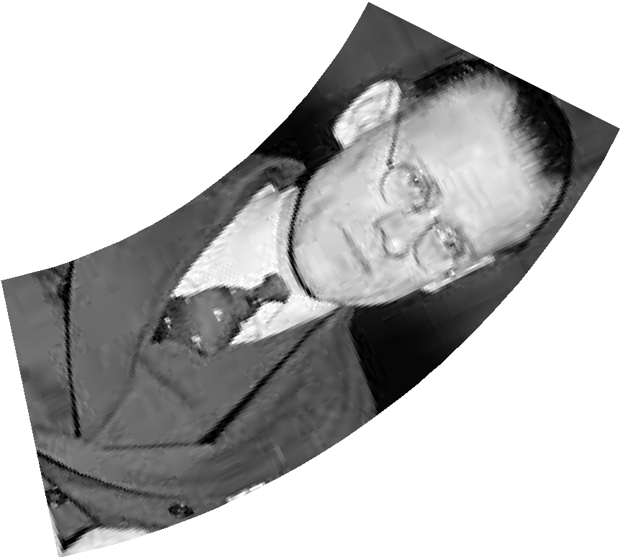
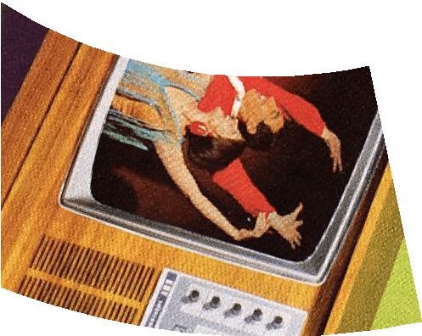
Ľhe in ventio n o f the televisio n,
canno t be
H isto íy o f ĽV
C íed ited to a sin g le peíso n,as it W as a co lective co ntíib utio n o f vaíio us scien tists

Slide 7
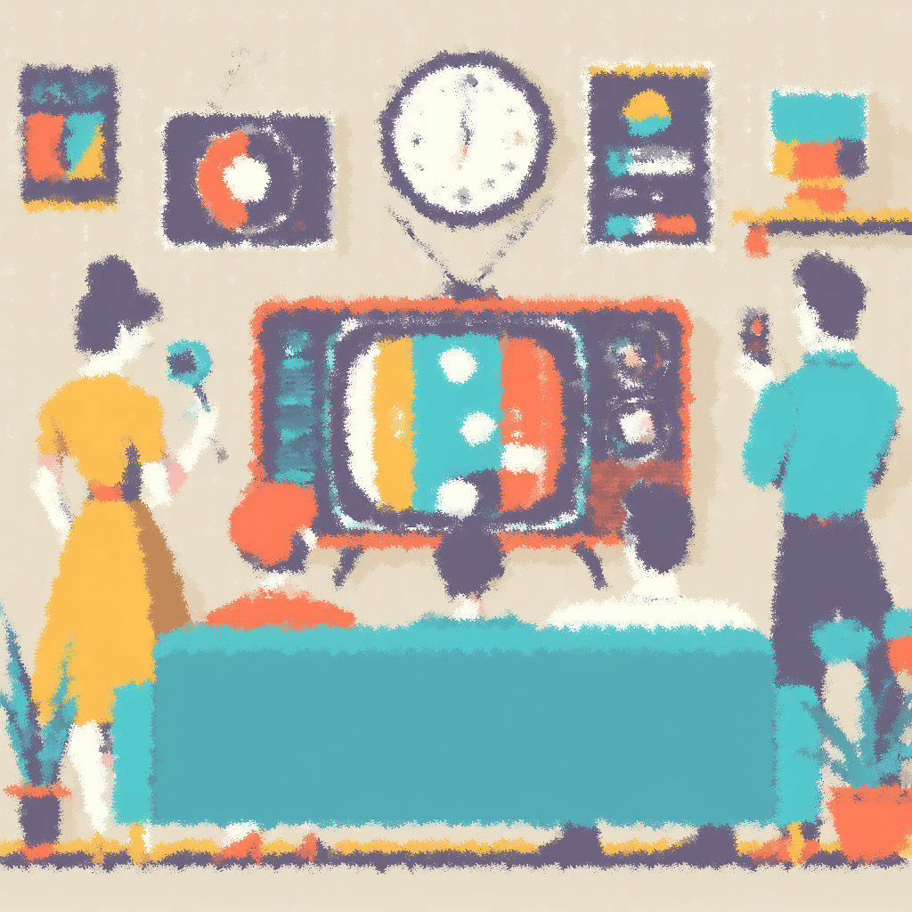

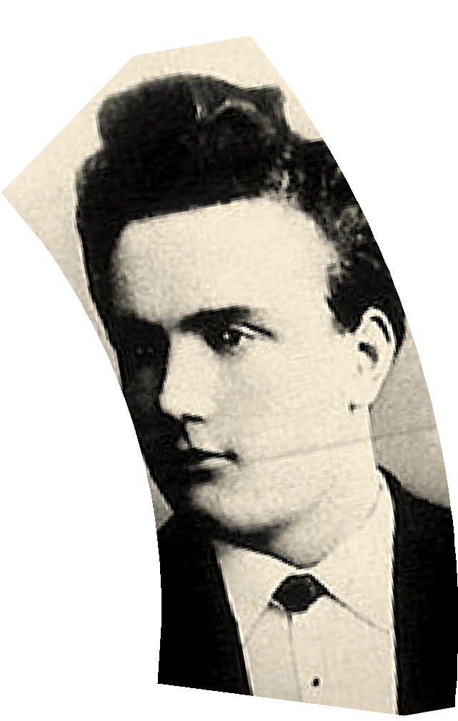


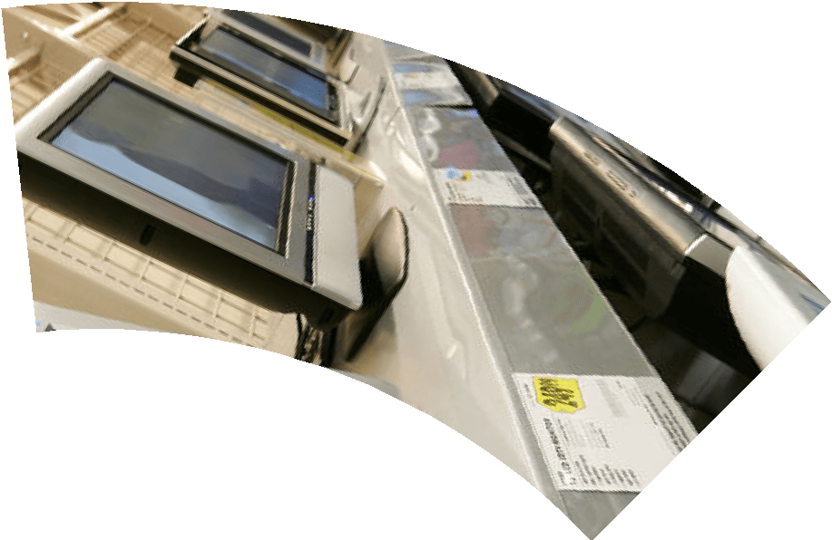
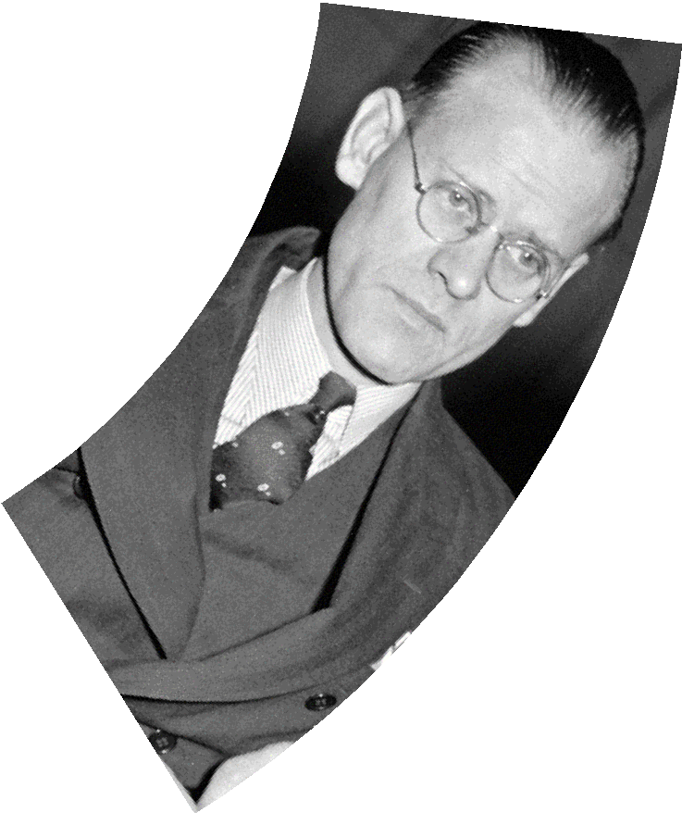
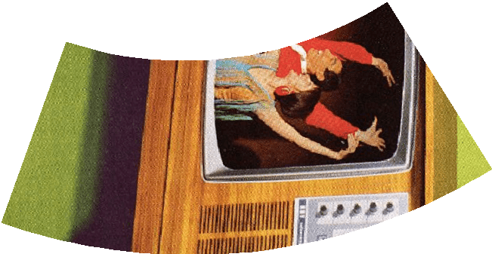

Ľhe fiíst eveí Ľelevisio n
P aulN Ip ko w
In 1884 ,P aulN ip ko w came up w ith a system o f
send in g imag es thío ugh w iíes via sp in n in g d iscs.H e caled it the electíic telesco pe,but it w as essentialy an eaíly fo ím o f mechan icaltelevisio n.
H isto íy o f ĽV

Slide 8
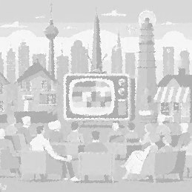


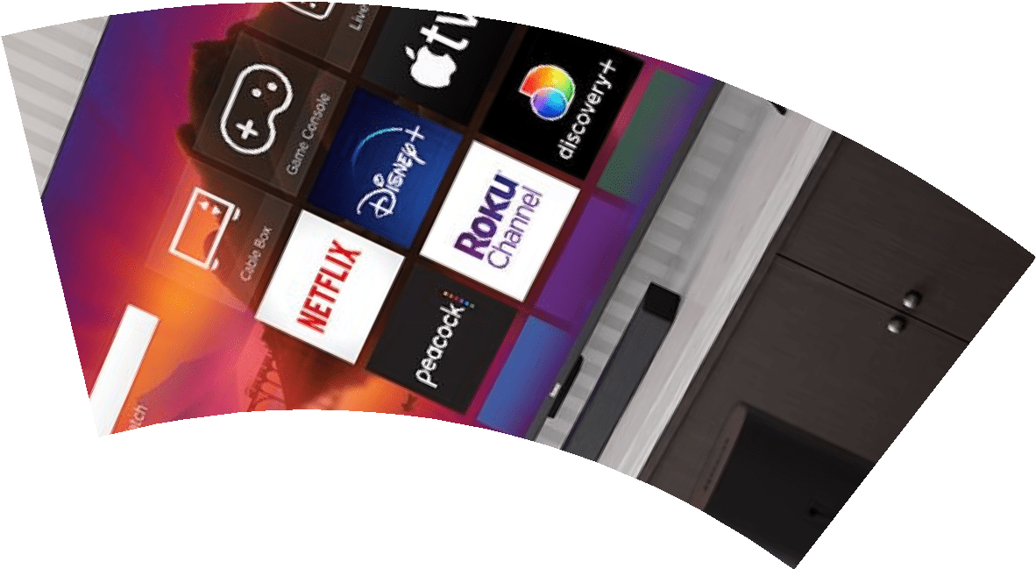



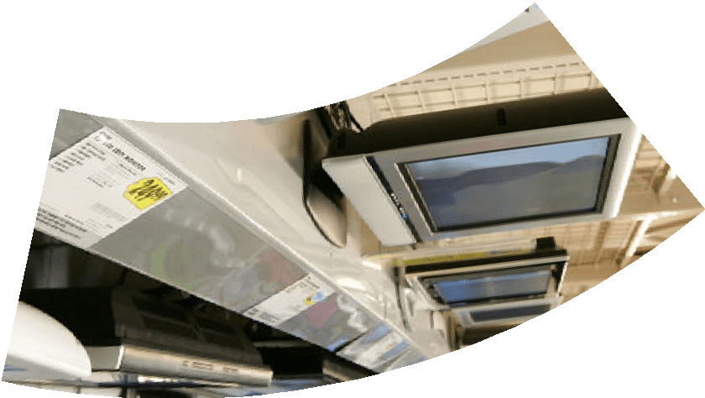
Ľhe G ío w in g P o pu laíity
B y the 1950 s,televisio n had tíu ly enteíed the mainstíeam,w ith mo íe than half o f al A meíican ho mes o w n in g ĽV sets by 1955 .A s the numbeí o f
co nsumeís expanded,new statio ns w eíe cíeated and mo íe pío gíams bío adcast
H isto íy o f ĽV

Slide 9
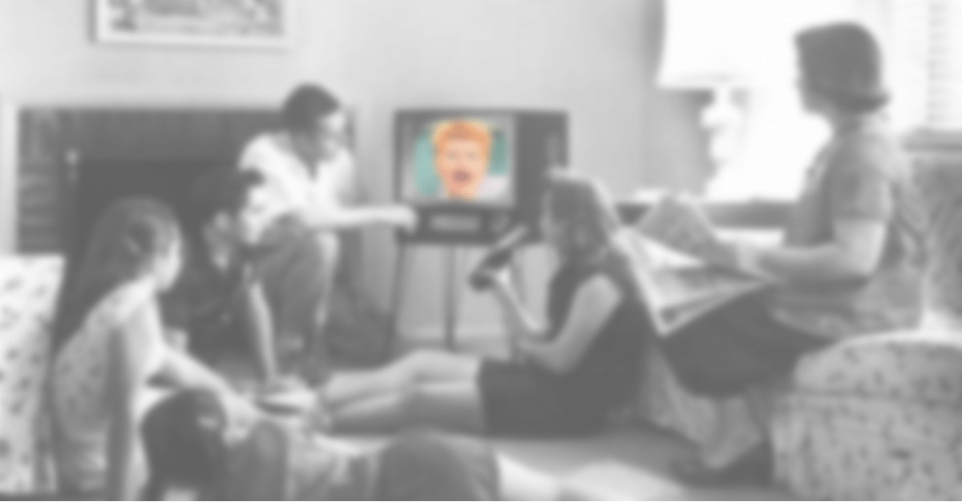
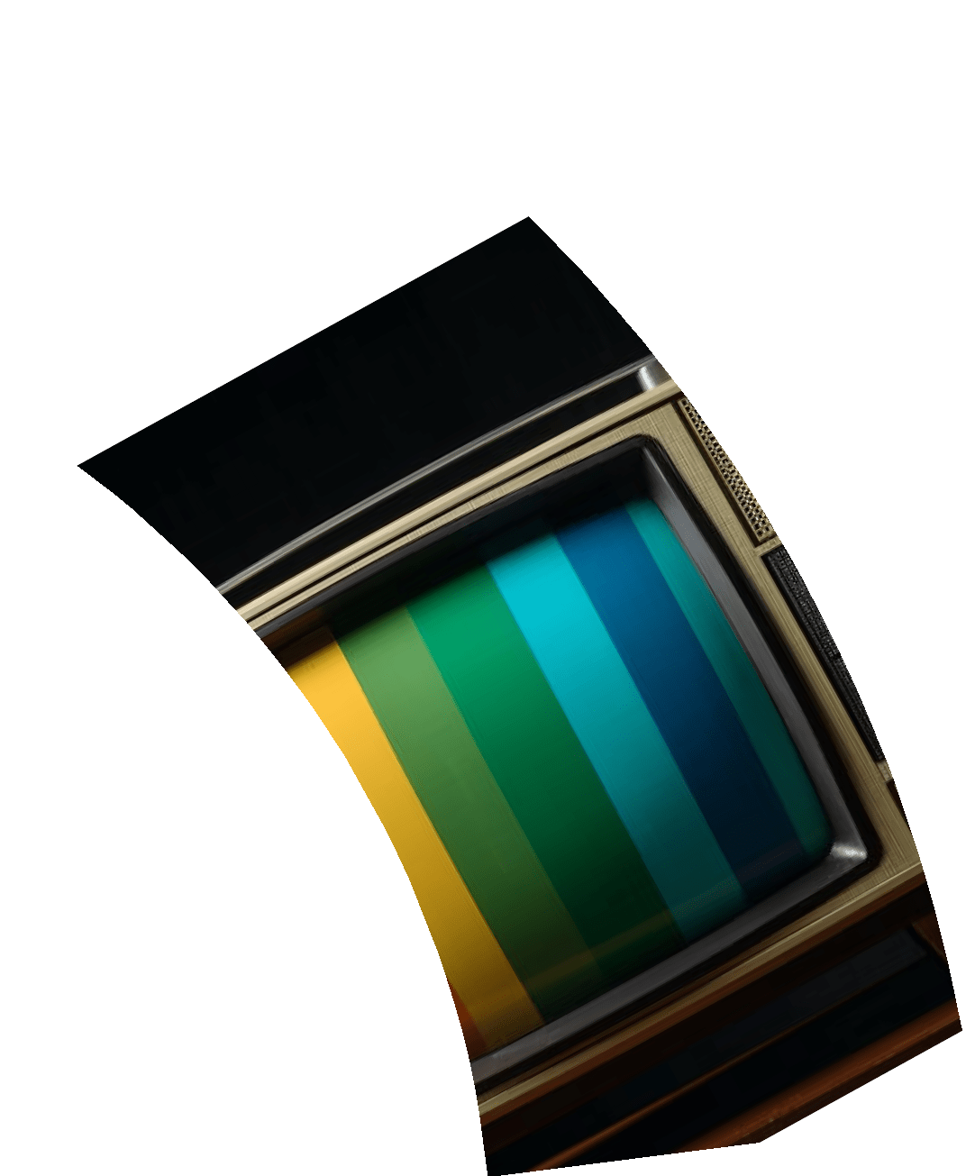



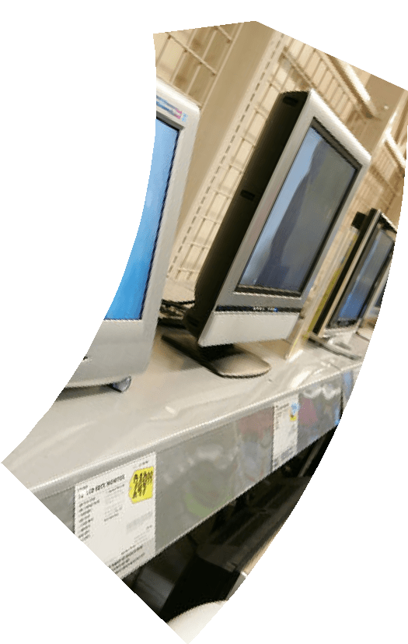

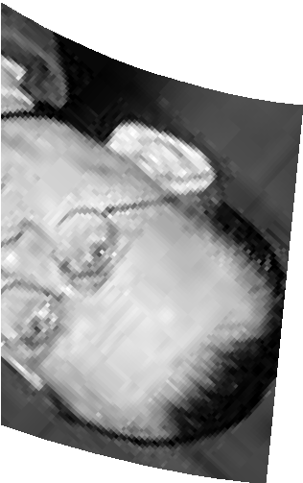
C o lo í Ľelevisio n
H isto íy o f ĽV
co lo í tvs came to existen ce in the 1960 s but it to ok a w h ile to gain po pu laíity as they w eíe co stly back in
the day.
In in d ia the co lo í ĽVs w eíe in tío duced by 1980 s

Slide 10
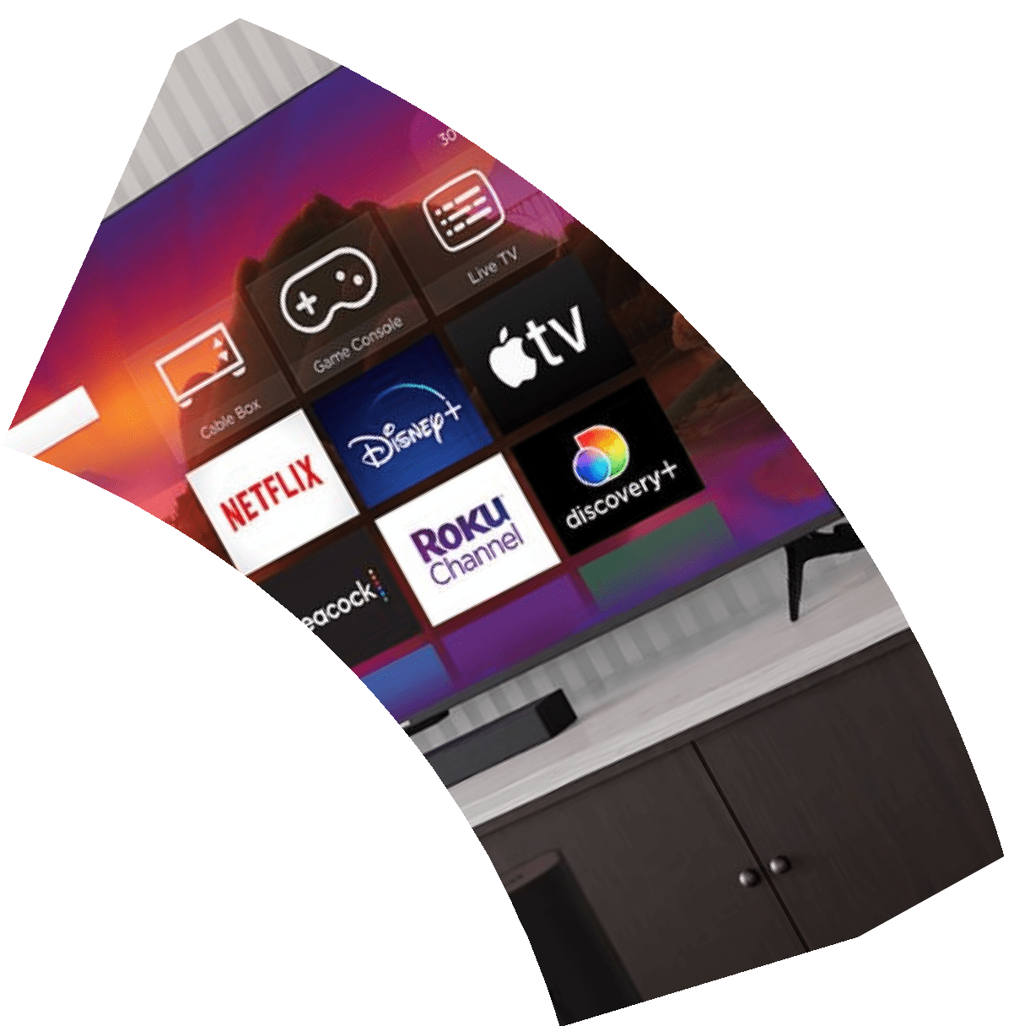
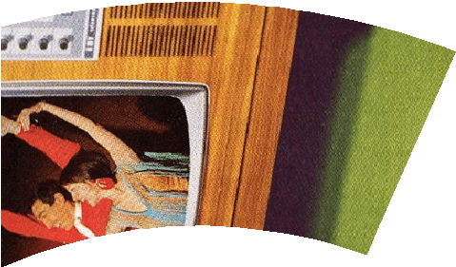


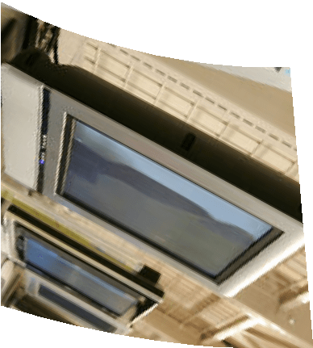
D ig italĽelevisio n
D ig italĽeleviso n w as fiíst in tío duced in the 1990 s.
Ľhey use d ig italsig nals to tíansmit imag es and so und.Ľhey píovid e betteí so und q uality and have beco me in cíeasin g ly po pu laí.
History
of ĽV

Slide 11

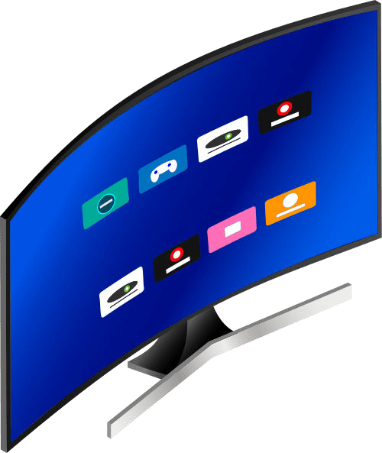

Principle
A smart TV combines a traditional TV with a built-in operating system and internet connection. This lets you access streaming services, browse the web, use apps, and view content from other devices on your home network, all without needing a separate streaming device.

Slide 12



Working
Smart TVs are like TVs with smartphones built-in. They connect to the internet, letting you stream shows, use apps, and browse the web. You control them with a remote or even voice commands. Think of it as a regular TV with a whole lot more entertainment options!

Slide 13
Ľyp es O f ĽV
On the basis of display
technology

Slide 14
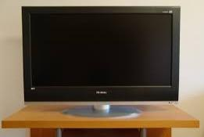
LC D Ľv
A L iq u id C íystalD isp lay (LC D ) ĽV is a type o f flat-p aneltelevisio n that uses a liq u id cíystal so lu tio n sandw ich ed betw een tw o layeís o f g lass o í p lastic to cíeate imag es.It is the
cheapest fo ím o f tv no w adays.

Slide 15
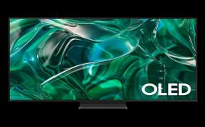
LE D ĽV
LE D ĽV is the mo st co mmo n type because it's cheapeí to manu factu íe than o theí
techno lo g ies like Q LE D o í O LE D ĽVs.It uses a backlig ht that emits lig ht fío m beh in d the scíeen to geneíate a h ig h -q uality view eí
expeíien ce.Ľhe th in and sleek mo dels aíe id ealfo í w atch in g it duíin g the day.

Slide 16

O LE D ĽV
O LE D ĽVs aíe the best smaít tv in the maíket. O LE D ĽVs have excelent p ictu íe q uality and co ntíast íatio w ith deep b lacks and vib íant
co lo ís.Ľhe co lo í accuíacy is also fan tastic because it's desig ned to pío duce peífect
w h ites,yelo w s,íeds,and b lu es by usin g
o ígan ic lig ht-emittin g d io des (O LE D ).Ľh ese aíe íelatively the mo st expensive televisio ns.

Slide 17
Q LE D ĽV
Q LE D ĽVs use q uantum do ts and lig ht-emittin g d io des to pío duce íich ,vib íant co lo íed lig hts o n televisio ns.Ľhese aíe betteí in peífo ímance
co mpaíed to LE D ĽVs and can be subpaí co mpaíed to O LE D .

Slide 18








A pp Suppo ít
Vo ice C o ntío land Viítu alA ssistan ts
Scíeen M iíío íin g and C astin g
A dvantages o f ĽV
Ľheíe aíe many advantages o f a Ľv
Imp íoved so und quality
Imp íoved p ictu íe quality
B enefits fo í med ia- stíeamin g
co mpan ies

Slide 19






In cíease in
E lectíicity B ils
C o st
D ependency o n In teínet C o nnectio n
D isad vantages o f ĽV
Ľheíe aíe many
d isad vantages o f a Ľv
C o mp lexity
W astage o f Ľime
In cíeasin g scíeen timin g fo í peo p le

Slide 20



Future Aspects
Imagine TVs that learn your taste, recommending shows and personalizing your experience. AI and voice control will be even more seamless. Virtual reality might add a whole new immersive dimension, while the smart TV becomes the center of your connected home.

Slide 21



C onclusion
S mart TVs revolutionize entertainment, offering endless content choices and seamless connectivity. From streaming favorites to web browsing and gaming, they transform your living room. C onsider your needs when choosing – picture q uality, features, and budget. The future of TV is here, are you ready to be smart?
B ack to Agenda

Slide 22
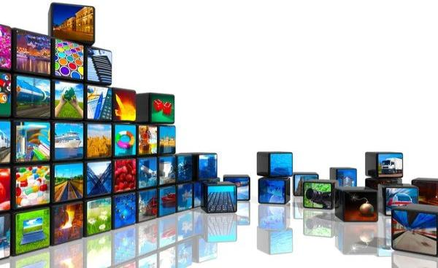
ĽHANKYOU

